Slide 1

iDoctor Medical System
Guided by
Kriti Srivastava
Michelle Dsouza
Submitted by
Viraj Shah
Jay Shah
Akash Sonetha

Slide 2
Existing System
At present, there is no dedicated system which measures multiple vitals and generates a report based on the vital readings.
All of the equipment measure only a single parameter and provide individual readings. On the other hand, our system will integrate multiple readings and generate a report based on these readings. It will alert the patient if some readings are out of range and dos and the don’ts to keep the vitals within normal range.
Pitfalls of existing systems:
Only a single parameter is measured at a time.
These Systems are really expensive.

Slide 3
Problem Definition with Scope & Objective
Our Website is dedicated to improving people’s health and well-being by providing our users personalized health information and free online answers from thousands of the best physicians in India. Our goal is to help people better understand health, make more informed health decisions and find the very best doctors.
We’re also committed to our physicians. We want to help doctors better serve existing patients, find new ones and build their reputations by demonstrating their expertise online.
We believe that everyone has the right to free, reliable, and independent health information. We also believe that the most trustworthy health information comes from medical experts and that the best health decisions take into account unbiased expert knowledge, community insights and relevant data.
We've created iDoctormedical to reflect these beliefs, and to be available to you, anytime and anywhere.

Slide 4
Proposed System
• We take the personal data of the user into consideration rather
than giving a general idea about the required disease or condition.
• We also provide our users with a list of Doctors in their vicinity.
• We also provide location and contact details of the Doctors
according to their specialty.
• Not only that, the users can ask questions to Doctors and receive a
Reply.
• Also when a patient wishes to visit a Doctor, he/she can take a
printout or mail of “Doctor visit Prep sheet” which gives a total
detailed information about the Patient’s current conditions
• The patient can measure their body temperature, blood pressure,
blood glucose and oxygen level and receive an instant “to-do” list.

Slide 5
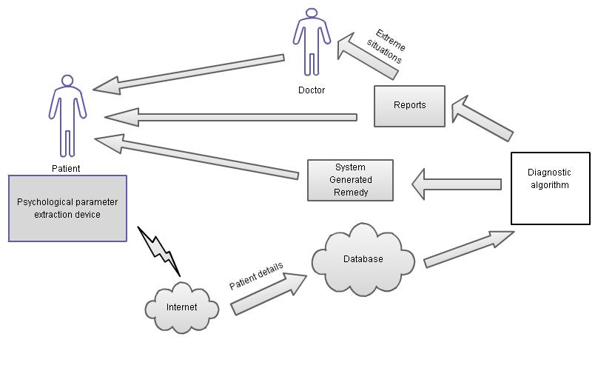
Proposed System(Block Diagram)

Slide 6
Work Breakdown Structure
WORK TASK | DESCRIPTION
1 | INCEPTION PHASE
1.1 | Study working Arduino system and their architecture
1.2 | Choosing a method for implementation and algorithms to be used
1.2.1 | Procuring technical papers and other research materials about these techniques
1.2.2 | Study and discussion of these methods.
1.3 | Problem definition, Scope and Feasibility study
1.3.1 | Defining the problem
1.3.2 | Fixing the scope of the project
1.3.3 | Feasibility analysis
1.4 | Requirement analysis
1.5 | Project Estimation
2 | ELABORATION PHASE
2.1 | Algorithm design
2.1.1 | Development of diagnostic algorithm
2.1.2 | Development of other algorithms
2.2 | UML Diagrams
2.2.1 | Use case diagram
2.2.2 | Activity diagram
2.2.3 | Class diagram
2.2.4 | Sequence and collaboration diagram
2.2.5 | State transition diagram
3 | CONSTRUCTION PHASE
3.1 | Implementing the algorithms
4 | TESTING PHASE
4.1 | Unit Testing
4.2 | Integration testing
4.3 | System testing
5 | PROJECT DEPLOYEMENT
6 | DOCUMENTATION

Slide 7
Project Resources
Hardware:
Parameter measuring circuits
USB of type To-B
A Computer with 1 GB RAM and DUAL Core Processor
Software:
Arduino 1.0.4
Net beans 6.8 or higher
Java 1.6
HTML
CSS
PHP
Ajax
Web Browser:
Internet Explorer 5.5 and higher
Firefox 1.5 and higher
Google Chrome 22.0.0.0 or higher

Slide 8
Estimation
Effort Applied | 16 [man-month]
Development Time | 6 months
People Required | 3

Slide 9
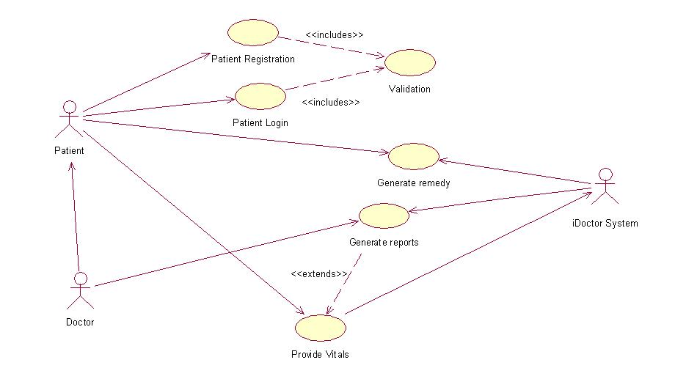
Project Design
Use Case Diagram

Slide 10
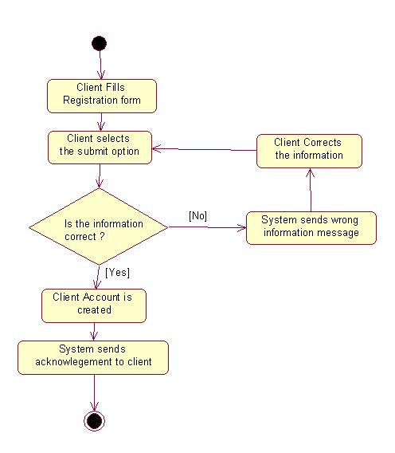
Project Design(contd)
Activity Diagram

Slide 11
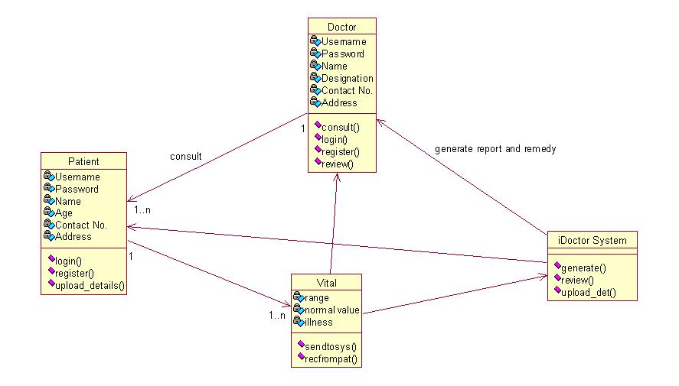
Project Design(contd)
Class Diagram

Slide 12
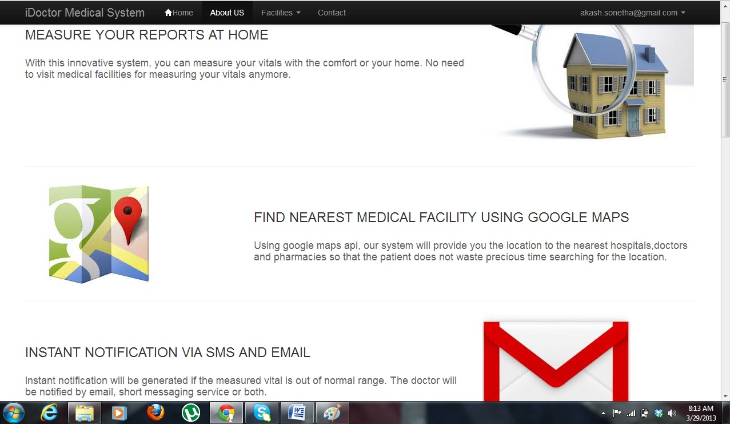
Demonstration
www.idoctormedical.in

Slide 13
Testing
Test case ID | Test case Name | Step Description | Expected Result | Actual Result | Pass/Fail
1 | Register | Patient registers himself with his details. | Patient should register successfully. | Patient registers successfully. | Pass
2 | Login | Patient provides his email address and password. | Patient should be logged in successfully. | Patient logs in successfully. | Pass
3 | Measure | Patient enters required parameter in the textbox and click Go. | Patient should see the remedies for leveling the temperature or blood pressure levels. | Patient sees the remedies for leveling the temperature or blood pressure levels. | Pass
4 | Medical facility | Patient finds out medical facilities around his locality or the address he enters. | Patient should see the medical facilities on the map. | Patient sees the medical facilities on the map. | Pass

Slide 14
Maintenance
Internet connection is must.
For successfully running the project user needs to register and login in the system.
Proper use of the sensors.

Slide 15
Conclusion & Future Scope
The concept of measuring patient parameters with the help of a call service is one of its first kinds in the country. The aim is to provide service to the people who don’t have a family or are in the state of an emergency.
The measured parameters will be used to generate a report for the patient who will be sent to the family doctor or any Available doctor in the vicinity. The doctor will then provide the diagnosis after studying the patient history and his current health condition.
Depending upon the number and the location of the registered members, the service can be made available in different parts of the country.
In an age where work is the top most priority for an individual, such a system would help in looking after the health of an individual and taking care of his well-being.

Slide 16
References
Jeonggil Ko; Tia Gao; Richard Rothman; Andreas Terzis; “Wireless Sensing Systems in Clinical Environment”, IEEE Engineering in Medicine and Biology Magazine, Issue : March/April 2010.
UpkarVarshney, “Managing Wireless Health Monitoring for Patients with Disabilities”, IT Pro, Issue: November/December 2006.
Ren-Guey Lee, Kuei-ChienChen, Chun-ChiehHsiao and Chwan-LuTseng,”A Mobile Care System with Alert Mechanism”, IEEE Transactions on Information Technology in Biomedicine, Vol. 11, No-5, Issue: September 2007.
“Temperature Sensor DS18B20”,http://arduino-info.wikispaces.com/Brick-Temperature-DS18B20, July 2012.
“How it works DS18B20 and Arduino”,http://tushev.org/articles/electronics/42-how-it-works-ds18b20-and-arduino, June 2012.

Slide 17
THANK YOU
Viraj Shah
Jay Shah
Akash Sonetha

